Slide 1
AOA U14 Report Jacques Reid
May 5-6, 2018 Caledon Ski Club

Slide 2
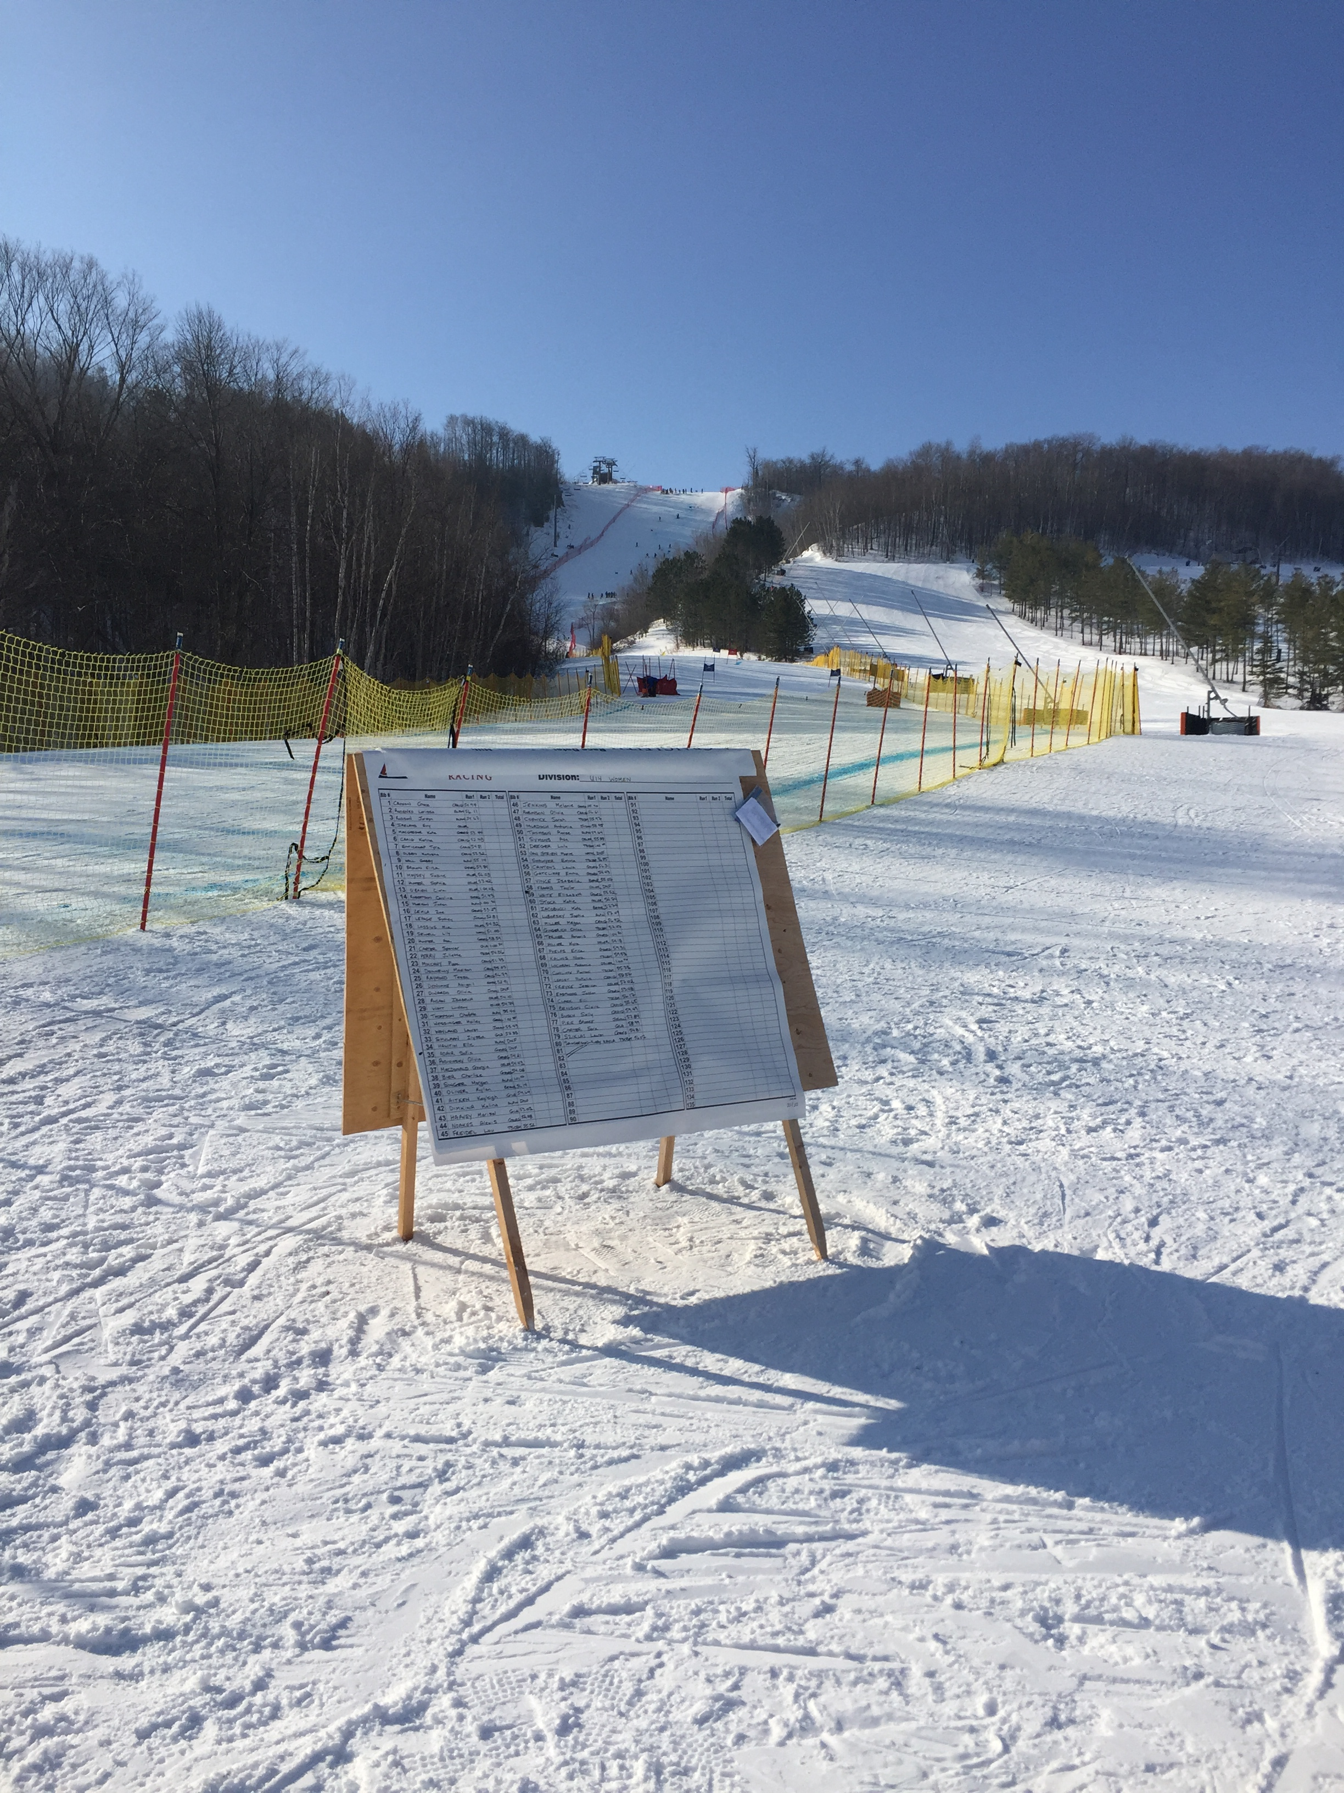
U14 Review Introduction
AOAC
Programming
In Season Highlights
Looking ahead
Notes:
AOAC:
Great group to work with with timely meetings, discussions and action items making all accountable under direction of Robyn and Kip
Continuity between age groups
Programming:
Goals for for the season…OCup Finals…Selections data…Marquee events (Mid Winter)
Highlights:
Mid Winters
OCup Finals
Duals
CanAms
Looking ahead:
Improvement & Progression…not radical?
Steps?
Collaborative

Slide 3
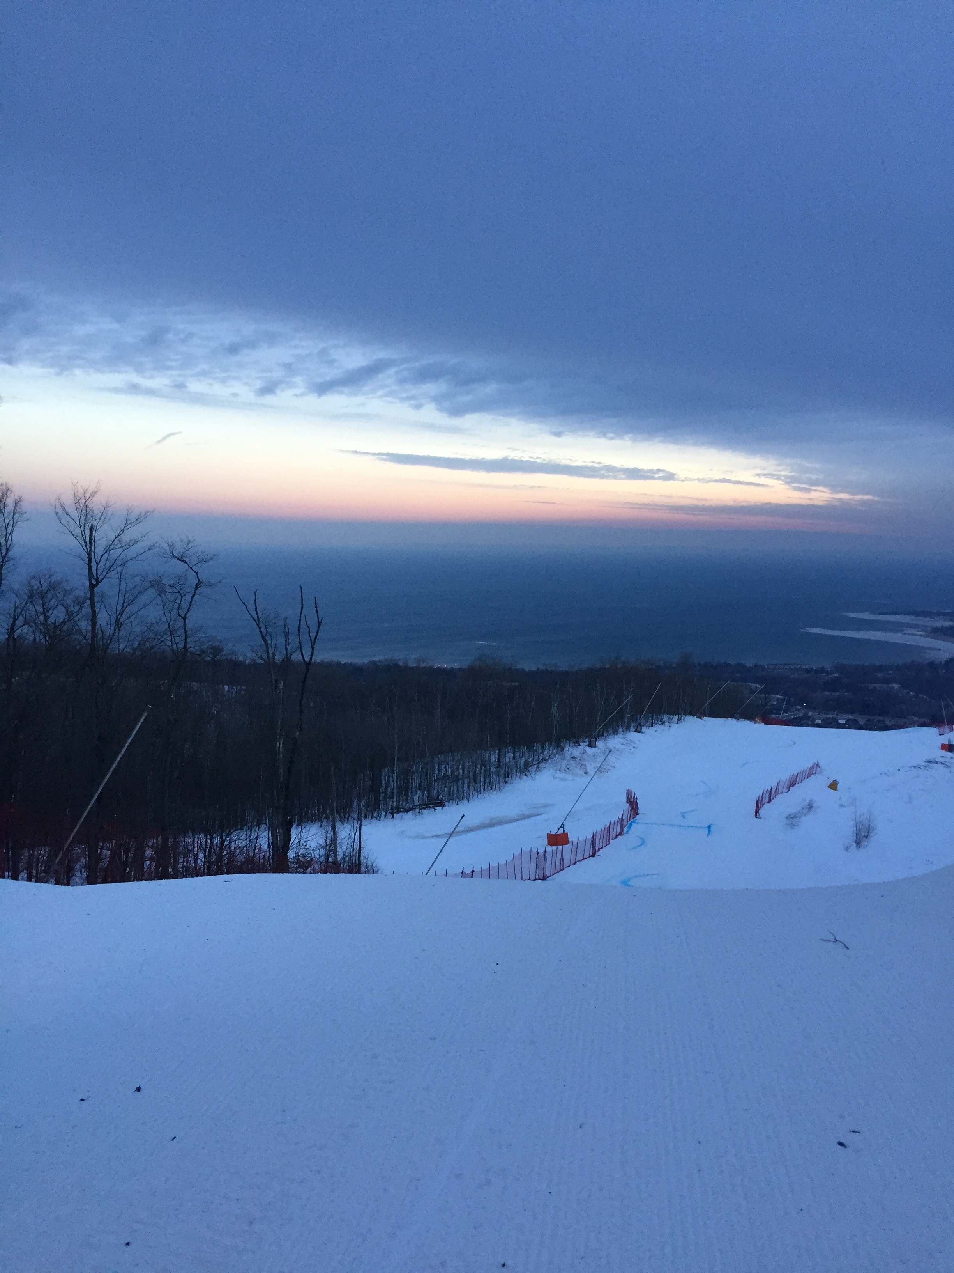
U14 Review Programming Overview
OCUP Finals quota
Mid Winter Series
OCUP Finals & CanAm
Selections:
Single runs for more data
“Best of” for SOD OCUP Series
SOD Champs for OCUP as well
Notes:
OCup Finals quota:
Better athlete experience
Manage fatigue
”Provincial Championship” should bring together the best
Make series more manageable for ROC’s
Mid Winters: (SG/GS/SL/Dual)
Exposure to multi discipline event before Provincials/ Open to all!!! In SOD without pressure cooker intensity of finals
Testing of dual event
Seeding and reverse 30 second run to match Finals
Parent education
OCup Finals selections:
Use of single runs to aquire more data and make each run count
“best of” format could allow for teams or athletes not doing all events
SOD Championship:
- U14/16 open to SOD Cup & OCup athletes where top 10 was a mix of both…U14 & 16 racing together

Slide 4
OCUP FINALS 2017
2017 OCUP FINALS

Slide 5
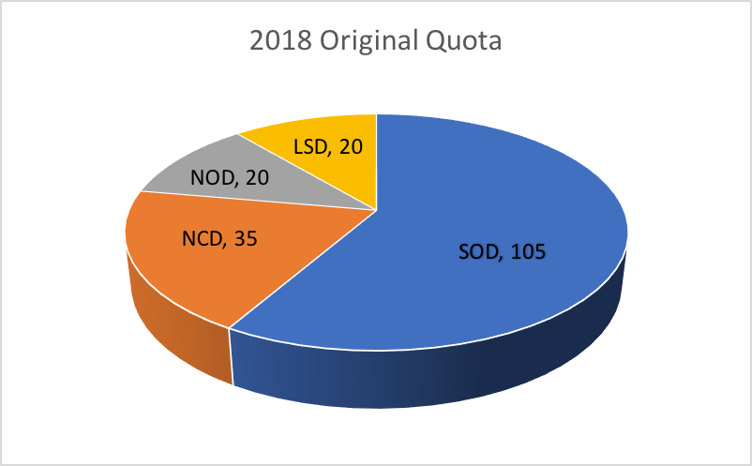
OCUP FINALS QUOTA 2018

Slide 6
OCUP FINALS
Searchmont Mar 13-17, 2018
SG/ GS/ SL/ Dual
Well organized by ROC
Observations:
180 participants is manageable
Dual was exciting but short
Course Setting needs to match event
Notes:
March Break
SG: 1 run race without training or free ski before hand…free ski was done on day before provincials where hill was open for free skiing
SL/ GS: These were good events overall and well run
Observations:
- 180 is manageable but max
Dual was a very exciting event...athlete, coach, spectator...it was also a great “equalizer” as it did not advantage bigger kids in fact, it seemed to advantage smaller kids with better skills
Course setting needs to be better as whole to match the event...what do we want a “championship” set to look like? No tricks, rythmical, challenging, variable???

Slide 7
CANAMS
Sugarloaf, Mar 28 – Apr 1, 2018
SG/GS/ SL…Skills cancelled
Team Ontario concept developed
2 day training camp
Teammate values contract
Jersey & Legends T-shirt
Performance... 6 top 10’s
SL!!!
Notes:
Challenging terrain and hard snow for GS/SG & snow conditions for SL(ruts)
Skills was a big focus but cancelled due to weather
Team Ontario:
2 day training camp…Teammate values contract, team meetings, parent meeting dealing with expectations
Event dayly recognition of best teammate
Technology restrictions and punishment
Performance:
6 top 10’s with many more opportunities
SL??? We had difficulty dealing with tough conditions (a bit of terrain, tight sets...Combo’s etc...)
We can do much better

Slide 8
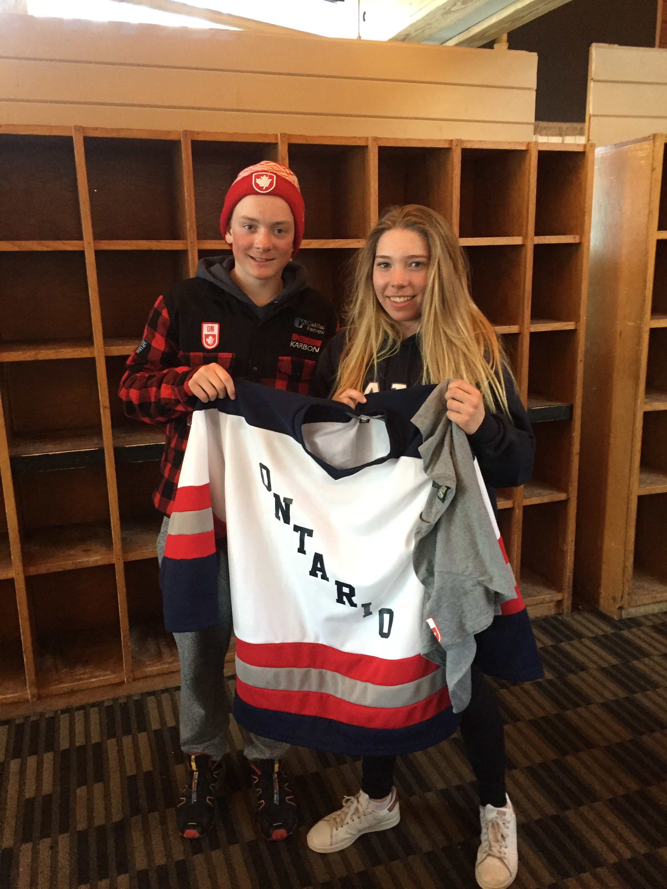
CANAM TOP 10’S

Slide 9
SELECTION OBSERVATIONS
SOD Selections based on Mid-Winter Series & SOD OCup races
Single Runs & Combined Results data spreadsheet
500 Pt. system
Updated twice
Observations:
Spreadsheet needs to be managed by SOD & more transparent with parents and coaches
Complex to explain
Lots of data…could be simplified

Slide 10
RACE FORMAT OBSERVATIONS
Random/ Reverse
2 Seasons
Pros & Cons
Similar format used across Canada at U14
Single run vs Combined result
1 run = 1 race?
Mix of the two
Single runs used for selections only
What is the goal?
Notes:
Random/ Reverse
Every run counts!!!
Single run vs combined:
Almost the whole rest of the country uses 1 run races at U14
Could help simplify selection data
Quebec success at CanAMs & U16 Nat’s
Goal:
Develop more versatile racers…able to ski all conditions
“Learn to Race” stage…there should be a progression
Tactics?
Engagement?
Atmosphere?

Slide 11
ATHLETICS & SKILL LEVEL OBSERVATIONS
Room for improvement
Good skills…in the gates…straightforward terrain
Ski Racing Fundamentals need to be “engrained”
SL???
How do we get there???
Notes:
Room for improvement: Ontario skiers need to be better “all round athletes” at this level…They should be encouraged to play other competitive sports during the off-season
Good overall skill level: As a whole, from watching Ocup Finals & CanAms, our skiers display good overall skill when in the gates & on straightforward terrain
Fundamentals: As discussed with Kip, we need to make sure our athletes understand the importance of good strong fundamental skiing
SL: In watching SL’s at U16 Nat’s and U14 CanAms, we need to be better!
How do we get there: working together, what are the fundamentals needed? More disussions in season, More challenging terrain,SL skills days!!!

Slide 12
LOOKING AHEAD
Race less?
6 Starts before Finals/ Not 9
2 in Jan/ 3 Mid W/ 1 speed in Feb
Prolong SOD season into MAR & APR
Skills days?
Include in Mid Winters/ remove SG
Add to SOD Calendar…Mar before Finals…improvements?
Collaborate on Fundamentals
Speed Philosophy
Notes:
Race Less:
2018:
8-9 SOD Ocup starts before Ocup Finals…Too much with addition of Mid Winters
should go down to 6
Skills days:
SL skills and discussions on Fundamentals
Added to Mid Winters while moving speed to Feb
Fundamentals: Race day discusions?
Speed Philosophy: We need a progression of speed skills from U12 to FIS...Where does speed at U14 fit into this?
Reduce amount of racing and work more on skills needed to ski at speed (terrain, gliding, tucking)
Push Speed events back into Feb? Pod Cup?
Use of SG skis for racing? U16 GS ski...

Slide 13
CONCLUSION
Highlights:
Mid Winter Series
OCUP Finals
Duals
Needs Improvement:
Speed Philosophy
Selection system & management
Transparency & Communication of goals
Implementation:
SOD U14 coach committee?
Decision timelines
Fall implementation and Conference Call importance!

