Slide 1
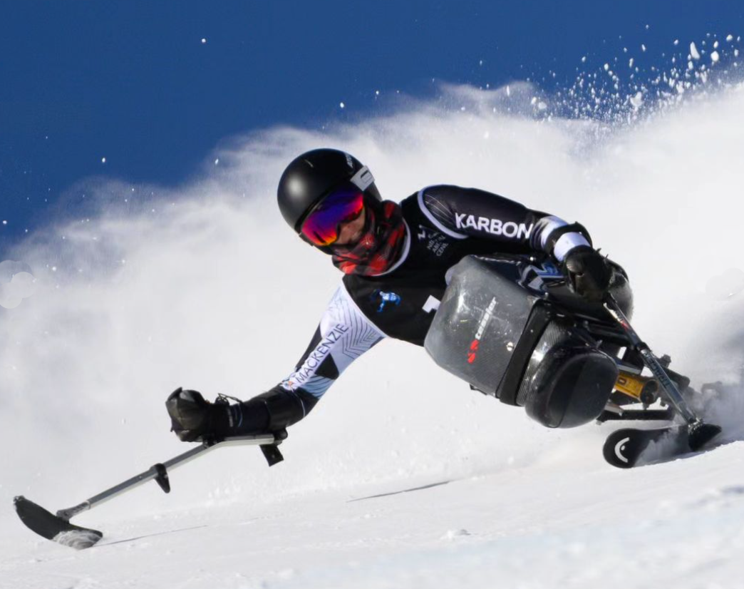
2024 COACHES CONFERENCE – ED REPORT
November 2nd , 2024

Slide 2
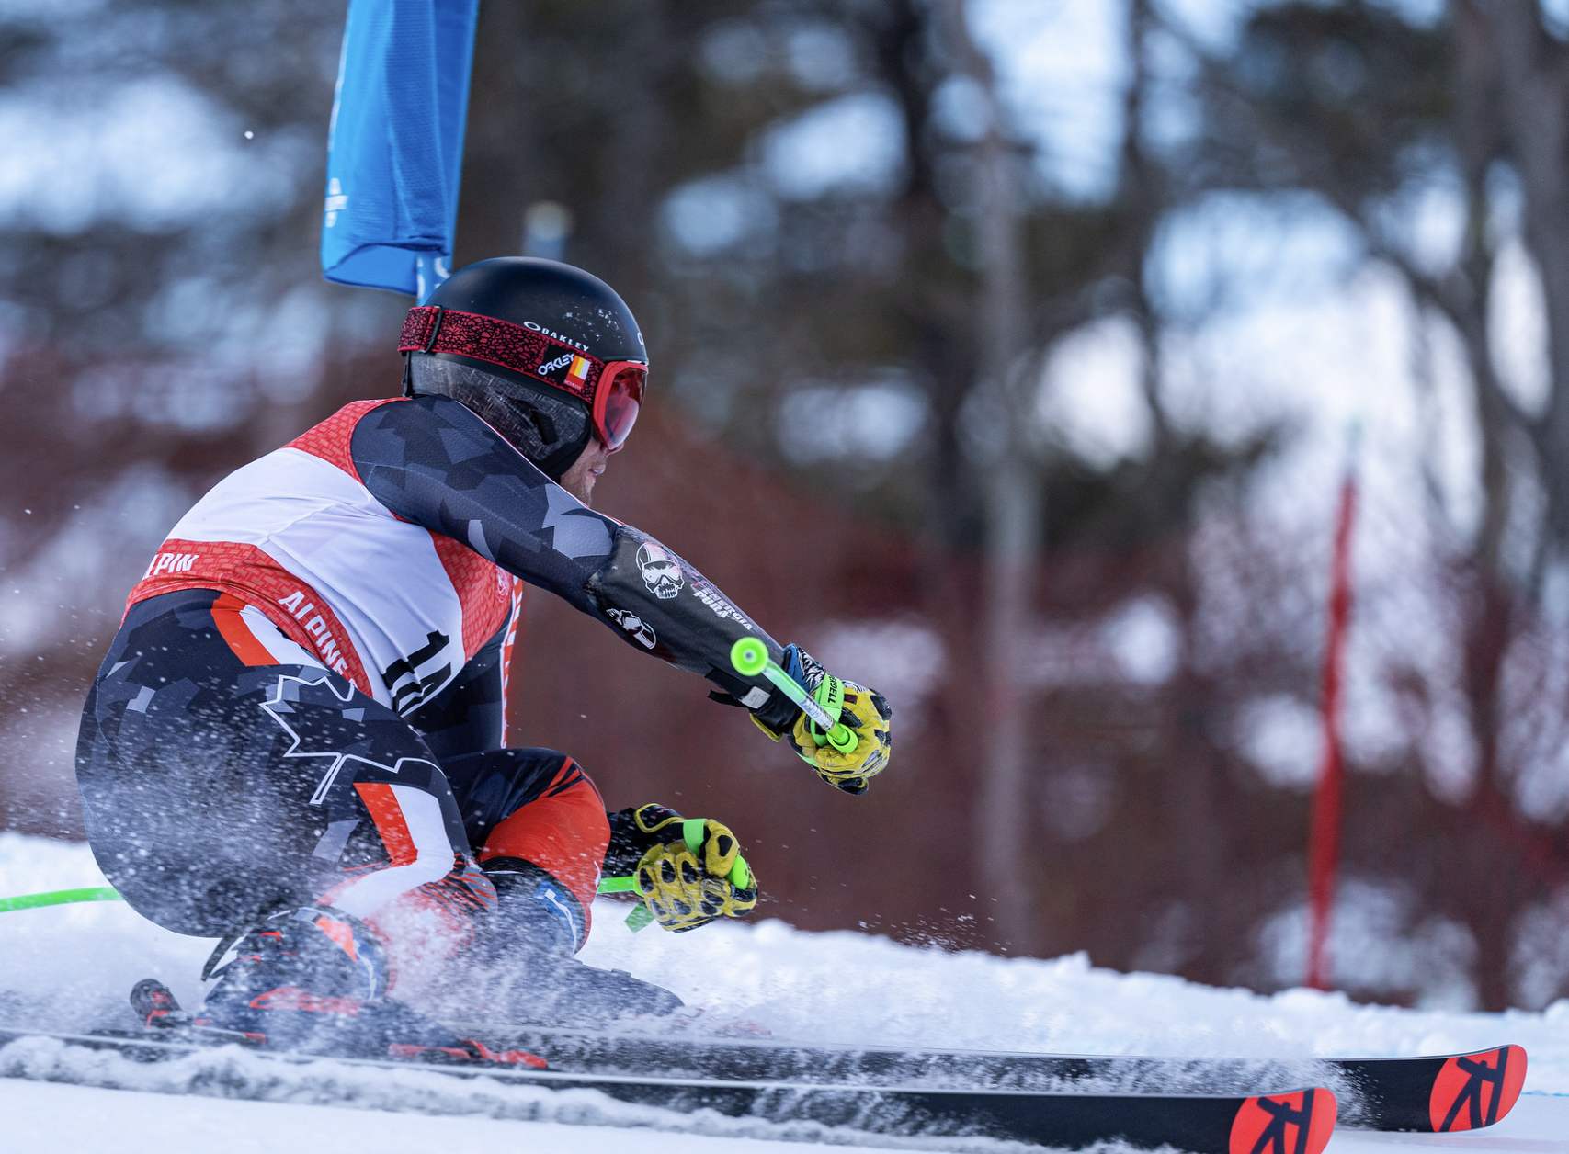
FOSTERING RESILIENCE
GUIDING
BEING POSITIVE ROLE MODELS
BUILDING CONFIDENCE
MOTIVATING
SUPPORTING
DEVELOPING DISCIPLINE
FOSTERING
TRUST & BELIEF
INSPIRING
KYLE BLANDFORD – CAST DEVELOPMENT TEAM
Notes:
You are the lifeblood of the ski racing system here in the province and country. Recognize the impact you have on the lives of these young people.

Slide 3
PTSO ROLES AND RESPONSIBILITIES
Ontario’s Sport Recognition Policy sets out the mandatory requirements provincial sport organizations and multi-sport organizations must meet to be recognized by the province.
PSO RESPONSIBILITIES
FOR THE PUBLIC, A PROVINCIALLY RECOGNIZED PSO/MSO PROVIDES
✓ developing their sports
✓ providing a competitive pathway for athlete development
✓ selecting provincial teams
✓ recruiting and training coaches, officials and volunteers
✓ conducting provincial championships
✓ ensuring they operate within their National Sport Organization (NSO) rules
Assurance the organization operates in a safe and effective manner
follows national standards when developing and offering a sport
offers high quality programs to their members
has certified coaches and officials
has established risk management policies (discipline, harassment, anti-doping, screening for volunteers etc.)
is working to promote participation from under-represented populations in Ontario
https://www.ontario.ca/page/sport-recognition-policy-provincial-and-multi-sport-organizations

Slide 4
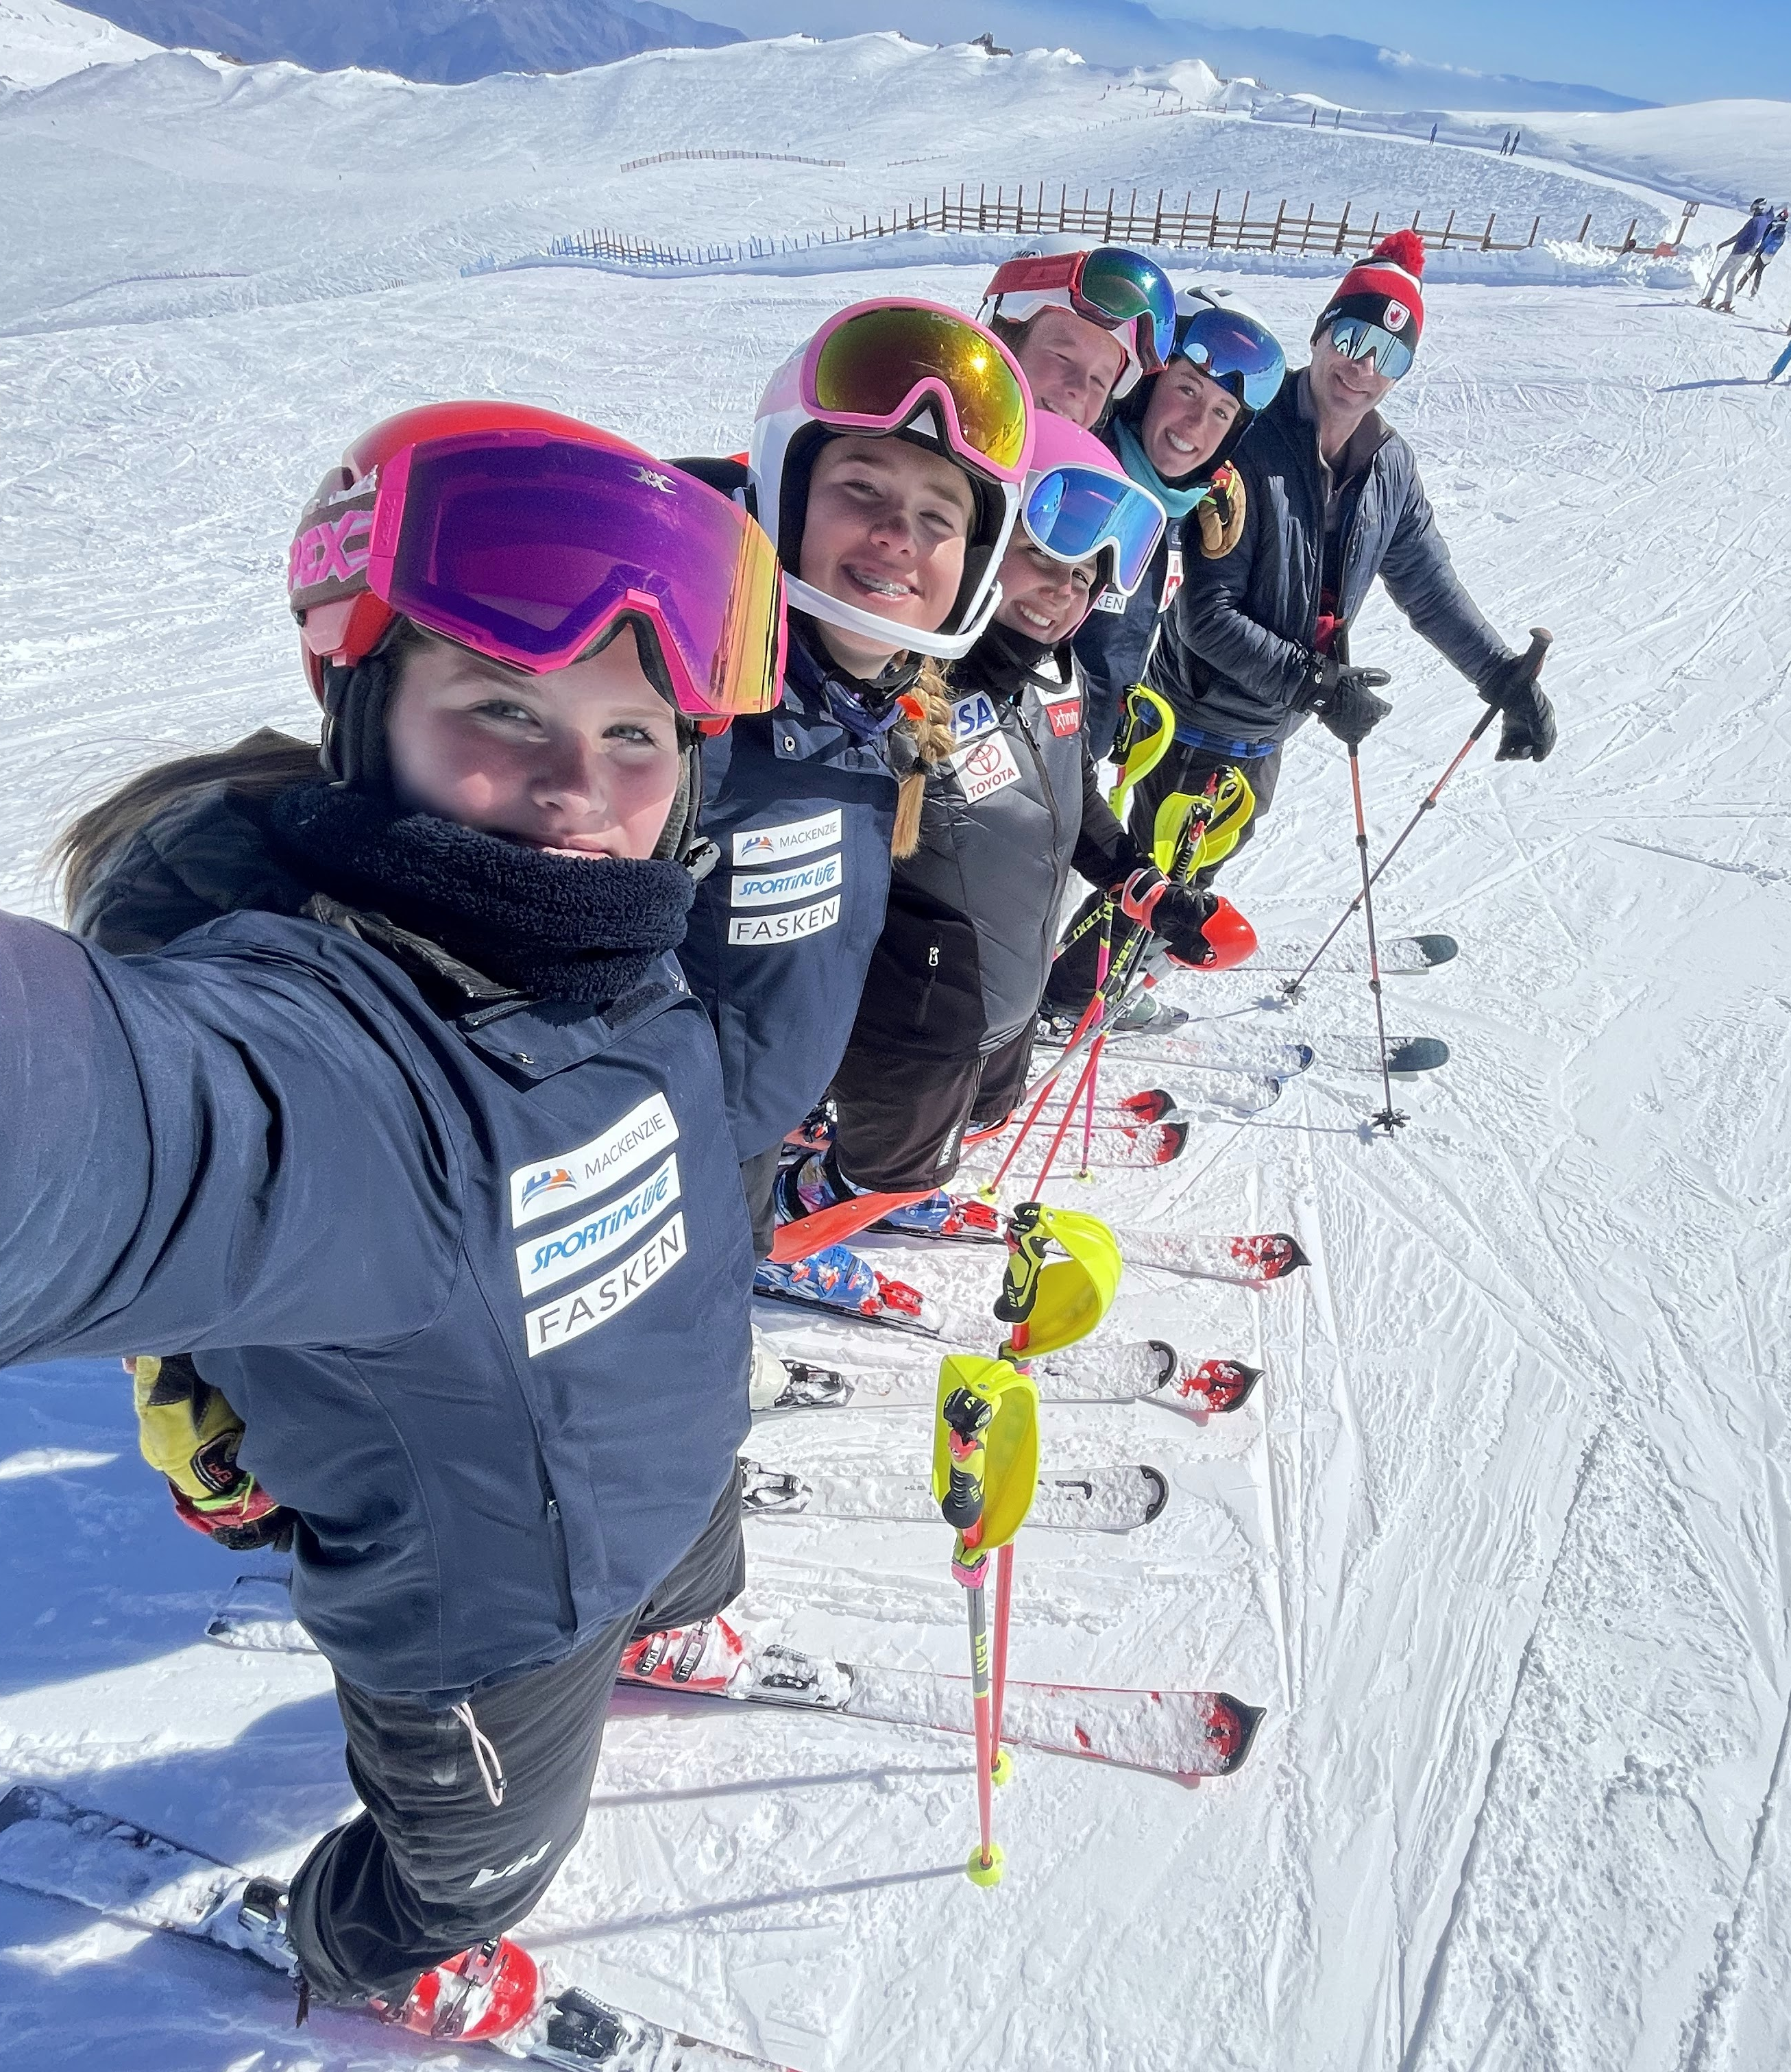
WHAT HAVE WE SET OUT TO DO?
VISION
A THRIVING SKI COMMUNITY FOR ALL
MISSION
LEAD, SUPPORT, AND PROMOTE THE JOYS OF SKI RACING WHILE DELIVERING A TRUSTED PATHWAY TO PODIUMS, COMMUNITY, COMPETITIONS, AND CAREERS
CORE VALUES
RESPECT, INTEGRITY, PASSION, ACCOUNTABILITY, INCLUSIVITY
ONTARIO UNITED – A PLACE OF BELONGING THROUGH POSITIVE EXPERIENCES FOSTERING GROWTH, INCLUSIVENESS, AND COLLABORATION

Slide 5
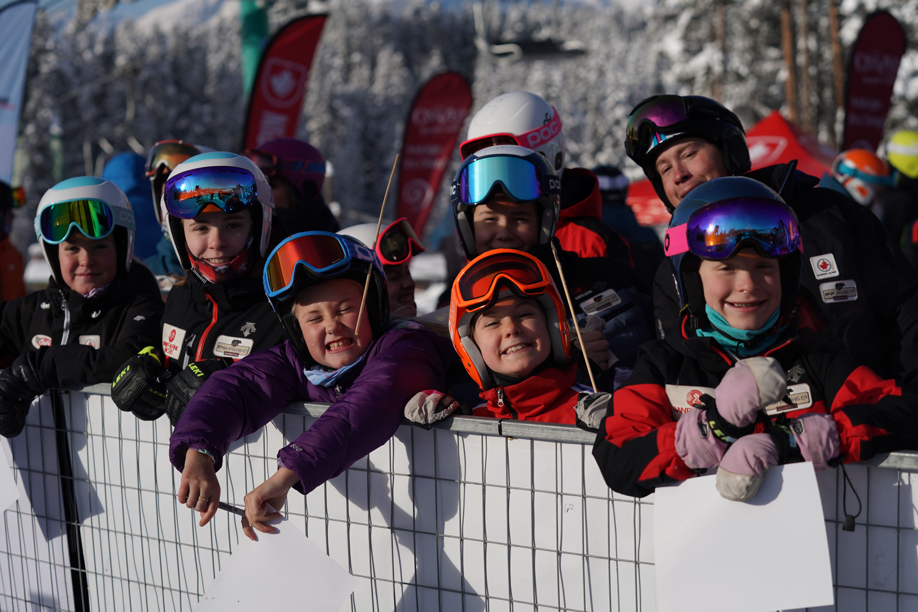
STRATEGIC PLAN – KEY PRIORITIES
OCT / 24
As an organization we must drive forward with resolve and agility, under-standing that our tactics and progress will be continuously assessed, adjusted and improved. A good plan is simply just the beginning.
The AOA strategic plan interval report is aimed to help showcase progress against the priorities set forth in our 2023-2028 strategic plan.
AREAS OF FOCUS
PRIMARY OBJECTIVES
A growing ski racing community that embraces inclusiveness and belonging
A trusted growth and development pathway that delivers value and performance success
AOA supporting coach and officials development across the province
Commitment to excellence in governance, financials and operations
STRAT PLAN ADVISORY GROUP 29 KEY ACTIONS

Slide 6
2023-24
INTERVAL REPORT
STRATEGIC PLAN

Slide 7
ONTARIO UNITED - ALPINE ONTARIO ALPIN STRATEGIC 2023-2028
A PLACE OF BELONGING THROUGH POSITIVE EXPERIENCES FOSTERING GROWTH, INCLUSIVENESS, AND COLLABORATION
2024-25 KEY PRIORITIES
Identify and support the diverse needs among clubs and athletes to provide programming that fosters participation and retention.
Proactively safeguarding participants through robust Safe Sport policy and promoting safe and inclusive environments.
Inspired Community
Enhance Skill Development and physical preparation by offering turnkey tools and resources aligned with ACA and accessible to all clubs and levels.
Increase access & exposure to SX and Super-G environments.
Athletic Development
Education and mentorship opportunities to develop and advance high performance coaches.
Increase recognition, valuing and belonging amongst officials & coaches within the community.
Coaches + Officials
Strengthen Alpine Ontario governance practices and align with current strategic plan.
Establishing clear roles, responsibilities and lines of communication to ensure the achievement of AOA’s vision.
Organizational Excellence

Slide 8
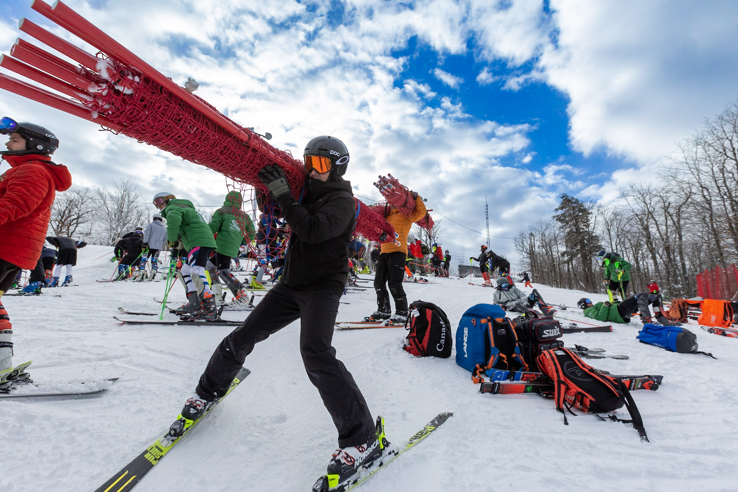
ACTION PLAN ITEMS UPDATE
Identify and support the diverse needs among clubs and athletes to provide programming that fosters participation and retention.
STATUS
24/25 FOCUS
1
BENEFITS
CURRENT ACTIVITIES
- A community that provides programing for varying skill,
development, and performance levels across all divisions
- New models of access and entry to ski programs
❑ Host second annual Canadian University Championships
❑ Schedule U18 events that unite racers and offer an alternative to FIS
✓ Integrate team racing component in SCUP series (SOD)
Proactively safeguarding participants through robust
Safe Sport policy and promoting safe and inclusive
environments.
STATUS
24/25 FOCUS
2
BENEFITS
CURRENT ACTIVITIES
- A growing ski racing
Community that embraces
Inclusiveness and belonging
❑ Developing new safe sport policy suite
✓ Securing independent third-party Safe Sport case manager
✓ Safe Sport training for participants

Slide 9
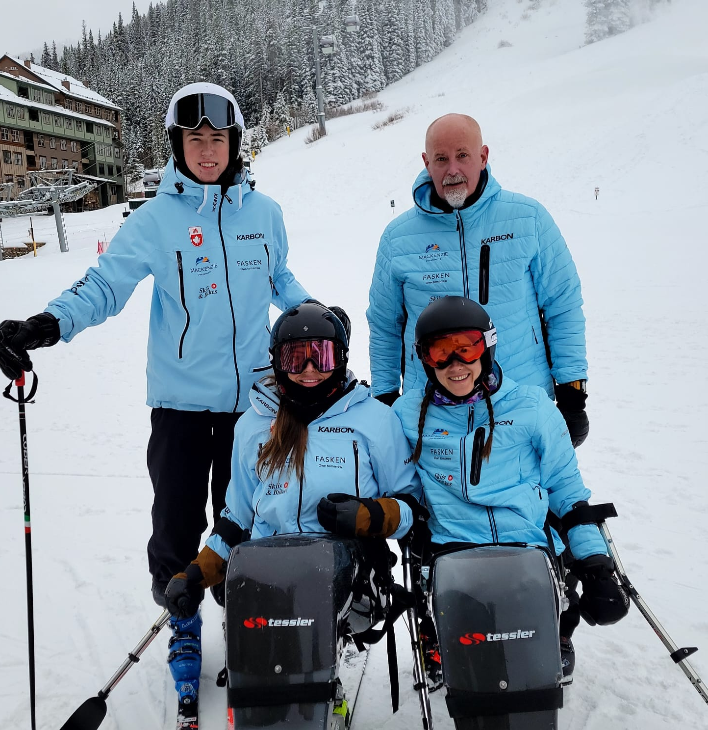
ACTION PLAN ITEMS UPDATE
Enhance Skill Development and physical preparation
by offering turnkey tools and resources aligned with
ACA and accessible to all clubs and levels.
STATUS
24/25 FOCUS
11
BENEFITS
CURRENT ACTIVITIES
Programs supporting “Healthy Humans” addressing performance, fitness, mental health, and educational requirements for athletes and coaches
❏ Train club/division reps on ACA smart-a-base fitness combine uploads
❏ Provide Fitness Combine guidelines and benchmark standards
Increase access & exposure to SX and Super-G
environments.
STATUS
24/25 FOCUS
12
BENEFITS
CURRENT ACTIVITIES
- Pathways and programs that allow Ontario athletes to
progress to the highest level of the sport.
❏ Develop annual plan of SX and SG camps and comps
❏ Collaborate with ON Snowboard to offer SX race series
❏ U16 SG Camp in Quebec/USA

Slide 10
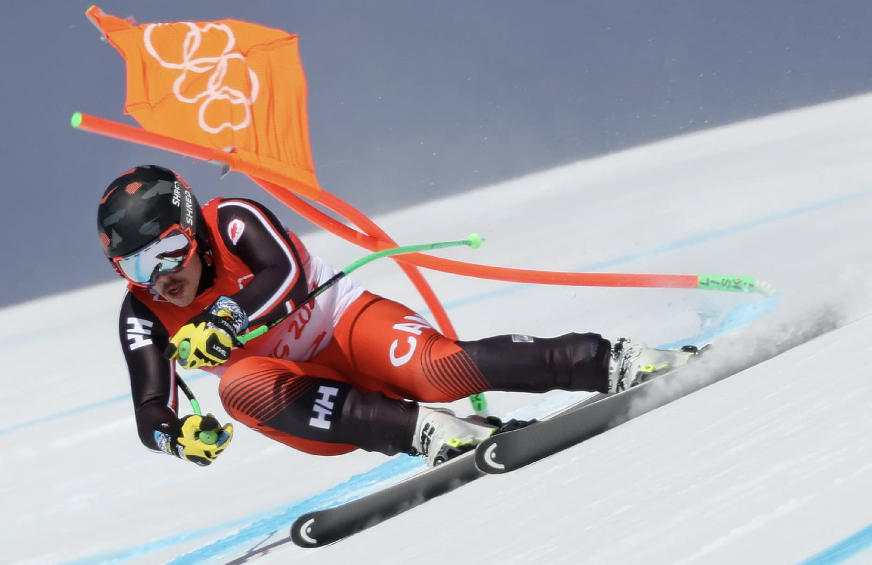
ACTION PLAN ITEMS UPDATE
Education and mentorship opportunities to develop
and advance high-performance coaches.
STATUS
ON TRACK
22
BENEFITS
CURRENT ACTIVITIES
Clear pathways to elevate and maximize the potential of
Coaches and Officials
❏ Engage HP consultant to attend summer fall camps as mentor
❏ Operate CoachUp opportunities with OST
❏ Develop summer camp Interface opportunities with OST/ODST/HPP
ON TRACK
Increase recognition, valuing and belonging amongst
officials & coaches within the community.
STATUS
24/25 FOCUS
21
BENEFITS
CURRENT ACTIVITIES
- Valued and engaged coaches across the province
❏ New Coach facilitator awards integrated in OSRA
❏ New Coach facilitator and officials jackets

Slide 11
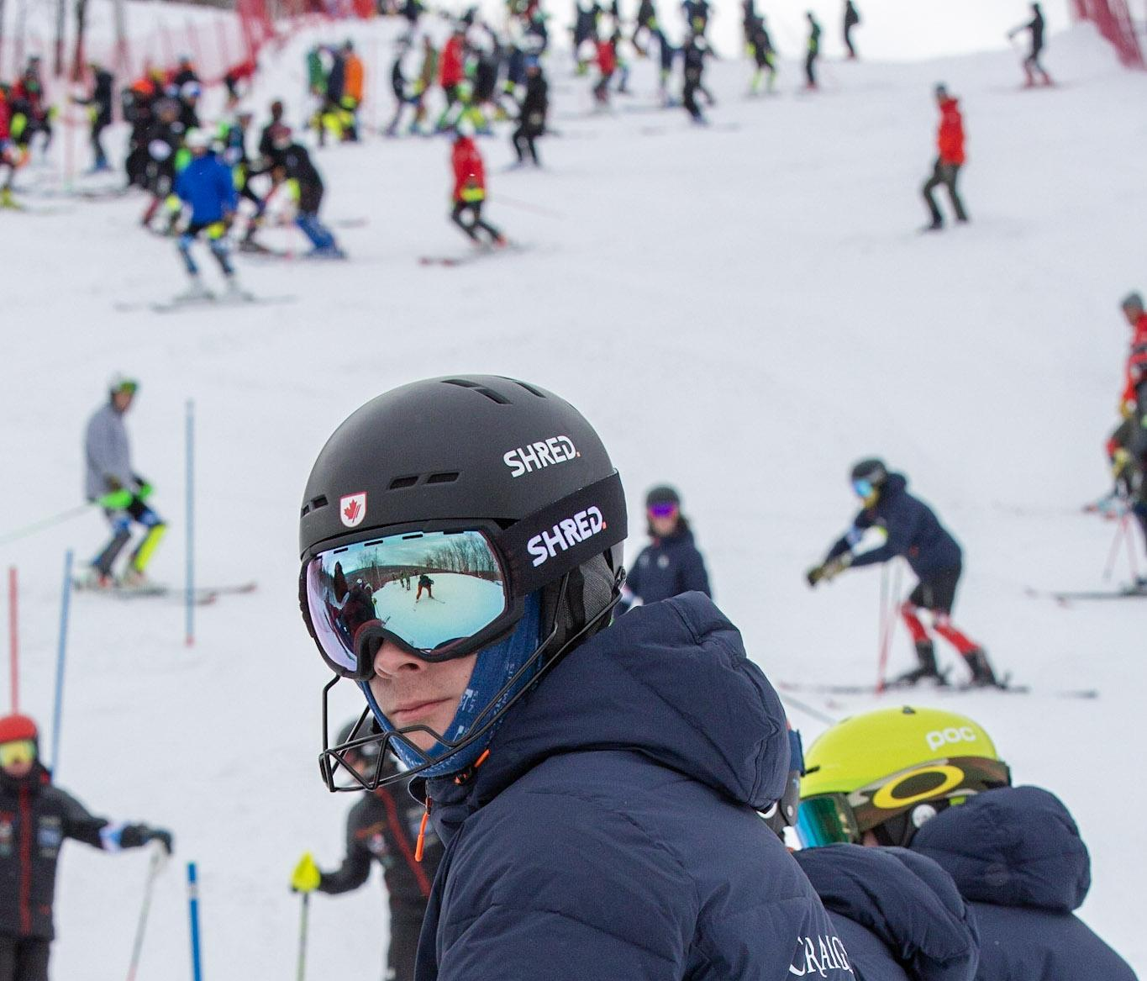
ACTION PLAN ITEMS UPDATE
Establishing clear roles, responsibilities and lines of
communication to ensure the achievement of AOA’s
vision.
STATUS
24/25 FOCUS
25
BENEFITS
CURRENT ACTIVITIES
Clearly define roles and responsibilities amongst
contributors
❏ Ministry Tracked KPIs
❏ Implement Action Plan tracker
Strengthen Alpine Ontario governance practices and
align with current strategic plan.
STATUS
24/25 FOCUS
27
BENEFITS
CURRENT ACTIVITIES
- Stable and sustainable best-in-class athletic leadership and programming
❏ Bylaws update in alignment with ONCA
❏ Code of Conduct policy update and Club/Division policy review
❏ Division MOU updates

Slide 12
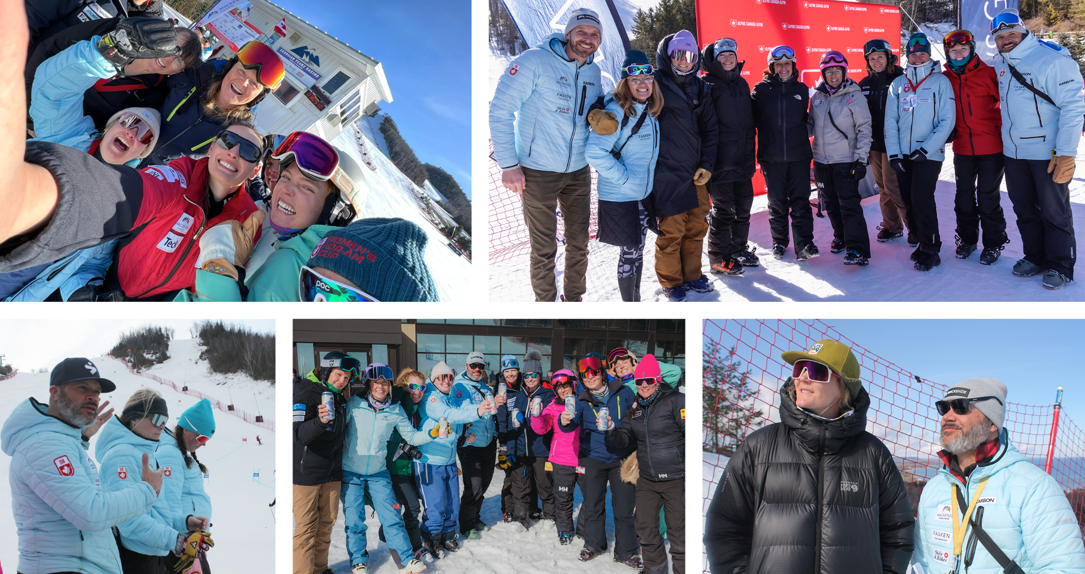
THOUGHTS OF THE DAY
MINDSET – What is great training?
OPPORTUNITY – all the perfect ingredients
CHALLENGE – facing change, how can we step up and meet that challenge with transformational coaching and a growth mindset
PERSPECTIVE – potential is greater than you may think.
IGNITE THE SPARK – WC Tremblant/CraigleithSX

Slide 13
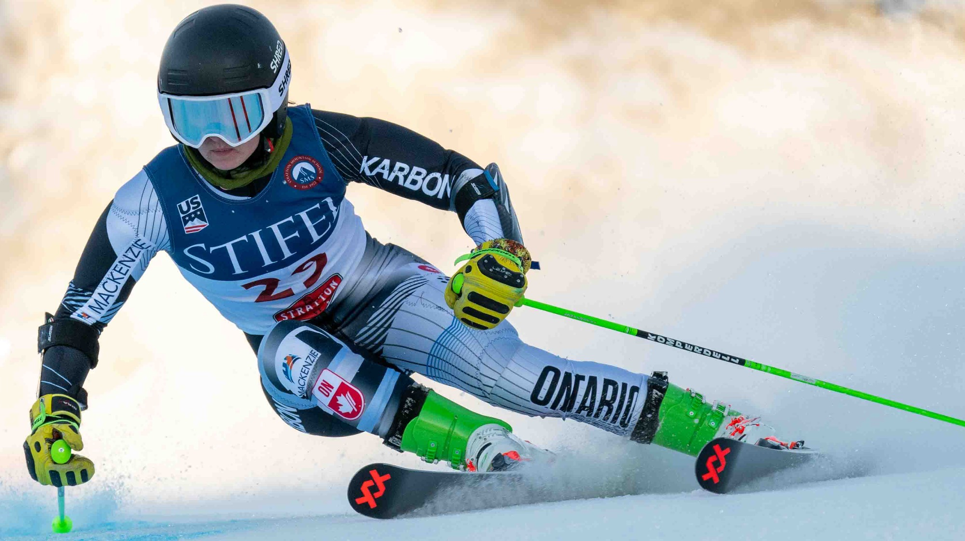
THANK
YOU COACHES

