Slide 1
SOD UPDATE
COACHES CONFERENCE

Slide 2
SOD Committee
Co-Chairs
Jason Manning – Chair /Treasurer Jen Gillard – Chair / Officials / Treasurer
Committee Members
Laura Berry- Secretary / Communications Tomaz Senk – Regional Liaison / Community Development Norm Greer – Regional Liaison/ Member Advisory Laura Misener – Regional Liaison / Governance Tim Buchanan – Athletics/ Governance Dave Campbell – Athletics / Coach Advisory Anna Gerol – Committee Member David Nighswander – Past Chair

Slide 3
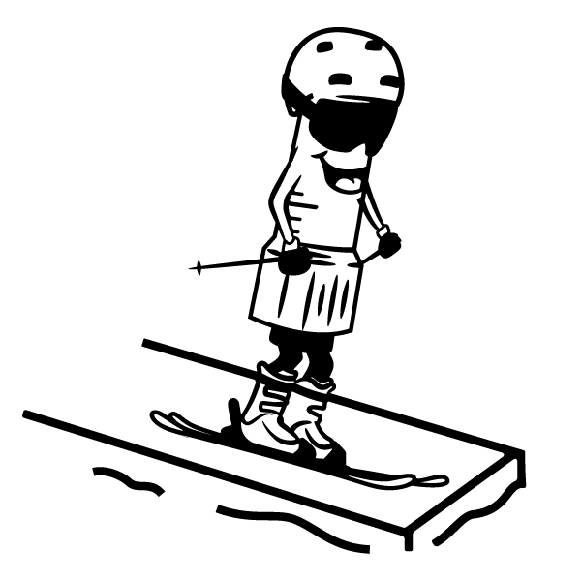
SOD Staff
Shawn Letton – SOD Manager (Mar– Dec)
Suki Chapman –AOA Program Manager/Member Service
TBD – SOD In-Season Manager (Dec – Mar)

Slide 4
SOD 2024/5 Goals
Structural Changes
U12 under U12 Development Banner
SCUP includes U14/U16/U18
U19 to U18
Supporting Coaches
Fitness Test Returned in 2024
Ski Cross integration focus
SOD Club Ambassador Program
Financial Support for the Coach Conference
SOD Spring Summit and Fall Scheduling Meeting
Supporting Administration Staff
New Team Scoring Website and Calculating Program

Slide 5
SOD Fitness Testing
York University September 28/29
140 Athletes Tested
U14 and U16 Test required for OCUP athletes
U12 Test focused on Learning the Skills and Movements
Test days ran smoothly thanks to all the volunteers who supported the event. It couldn’t have happened without them.
Big Thanks the Fitness Test Committee
Stefan Overgaard
Catherine Strus
Kiersten Sutherland

Slide 6
U12 Development
Why the Change to U12 Development?
U12 is a feeder to the SCUP or OCUP circuits
U12 is built around staying in bracket for the full season
U12 Development
SCUP
OCUP

Slide 7
SCUP
SCUP Schedule is Live in Draft form on the AOA site!
SCUP continues both an Individual and Team Scoring Focus
New SCUP Website hosting athletes individual and team scores
Access to OCUP Finals from SCUP will be based on a standalone race held on a Friday in February. Clubs will receive quota for this race selects athletes that will attend

Slide 8
SOD Ski Cross
SOD has assembled a Ski Cross Committee to help educate resorts/operations managers, coaches, officials, athletes and parents around Ski Cross.
The committee’s goal is to increase awareness of cross and train more coaches, officials and builders to deliver cross as well as educating parents and athletes around cross
The committee is working to integrate Cross into Development and SCUPs event series for 2025/26

Slide 9
Ski Cross Committee
Victoria Fenninger – Chair
Paul Plotz
Tom Vincent
Brad Lashley
Brad Neil
Cam Farrell
Charles McGee Jennings
Rob Dunlop
Henry Haiduk
Sean Miller
Alex Thayer
Tim Buchanan

Slide 10
SOD Club Representatives
SOD will be reaching out to Head Coaches to help find a lead coach to act as an SOD rep.
The SOD reps will have a couple of short meetings pre and in-season so they have the latest info from SOD. The goal is to have more than just the Head Coaches help inform other coaches, athletes and parents on what SOD is doing to support the race community

Slide 11
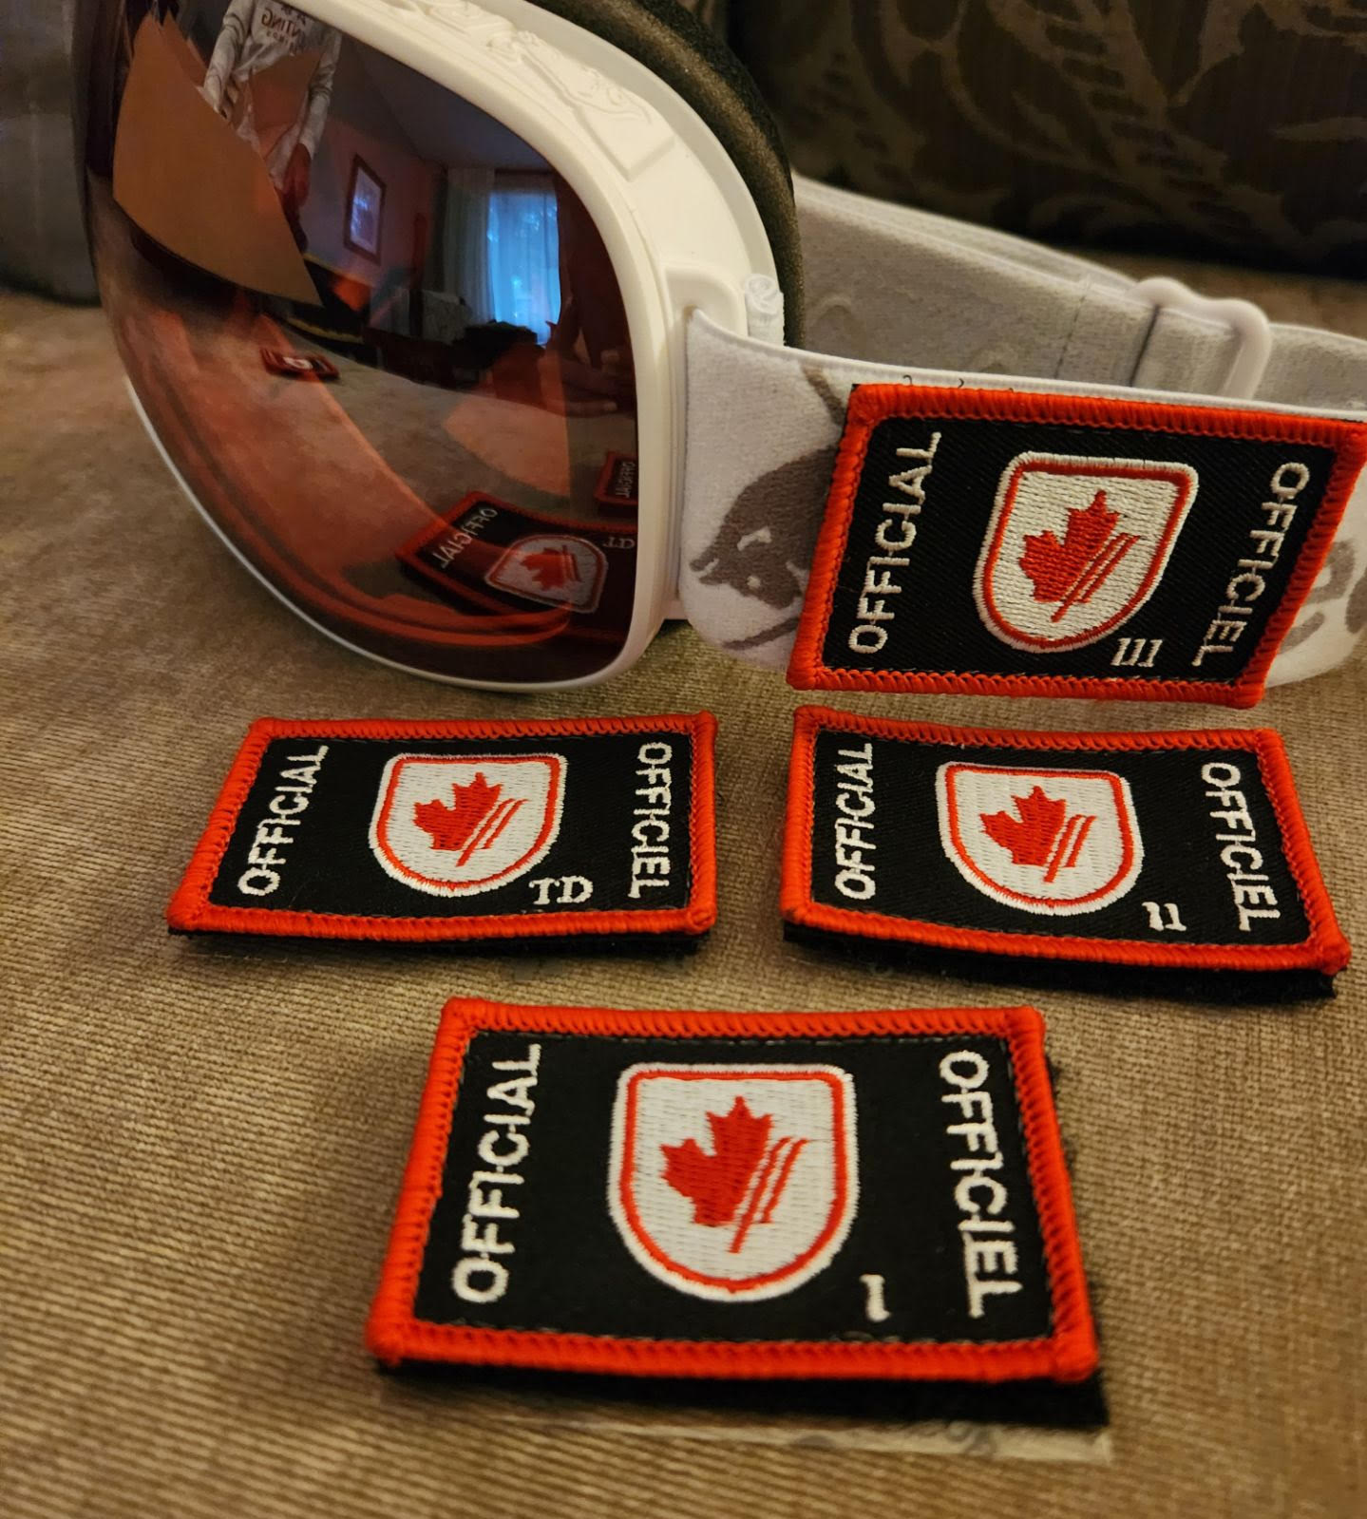
SOD Officials Support
SOD will be sending all registered officials our new officials patches to help identify them both at the clubs and on race days

Slide 12
Thanks!

